Slide 1
Heart Disease Prediction
By: Theodore Koby-Hercsky
Presentation Link: https://youtu.be/wTrhfby78sA

Slide 2

Heart Disease
Group of disorders of the heart and blood vessels
Coronary heart disease
Cerebrovascular disease
Rheumatic heart disease
Leading cause of death globally
Taking 17.9 million lives a year
One third of these deaths occur to individuals under 70 years old

Slide 3

Project Overview Heart Disease Prediction
Review and prepare Heart Failure Data
Create models for prediction
Predict patients experiencing heart failure
Determine model best for prediction

Slide 4
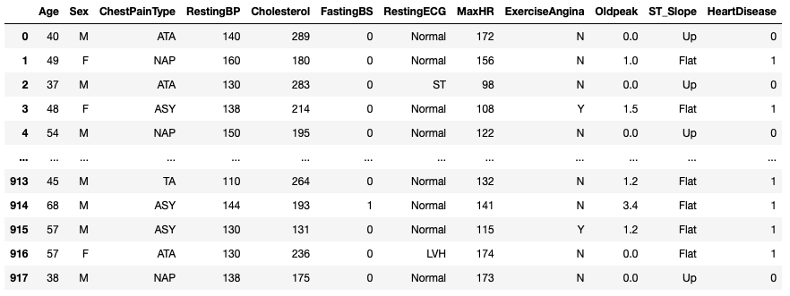
Data Overview Heart Failure Data
MaxHR – Maximum heart rate achieved 12 variables
Oldpeak - Numeric value measured in depression
Heart Disease – 1 heart disease or 0 normal
Exercise Angina - Induced angina Yes, No

Slide 5
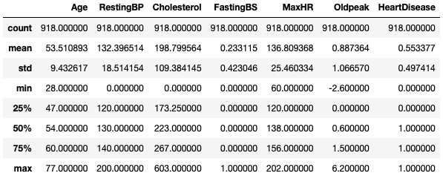
Heart Failure Data Described
Mean Age - 53
Mean Heart Rate - 136.80
Resting and Fasting Blood Pressure – Minimum is zero
Cholesterol - Minimum is zero

Slide 6


Data Validation
Duplicates in data set: 0
Missing values in data set: 0

Slide 7
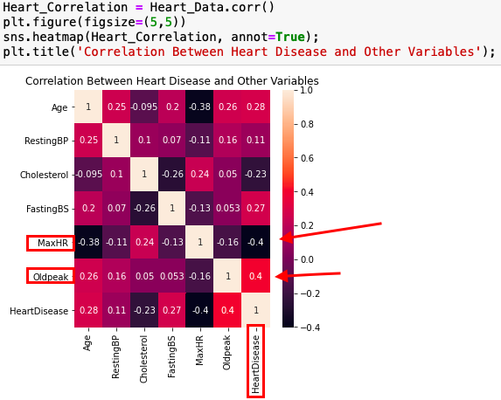
Data Visualization
Heart Disease and Oldpeak: 40%
Heart Disease and MaxHR: - 40%

Slide 8
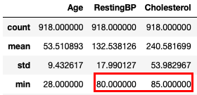
Data Cleaning
Replacing Zero Minimums With Median Rate
Resting Blood Pressure - zero
Cholesterol - zero

Slide 9
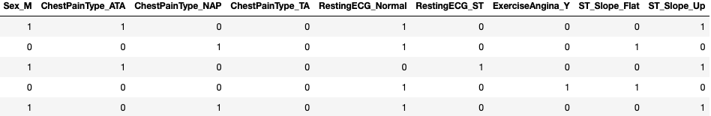
Creating Dummy Variables
Dummy Variables for Categorical Variables
Sex
Chest Pain Type
Resting ECG
Exercise Angina
ST Slope - slope of the peak exercise

Slide 10
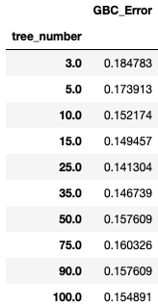
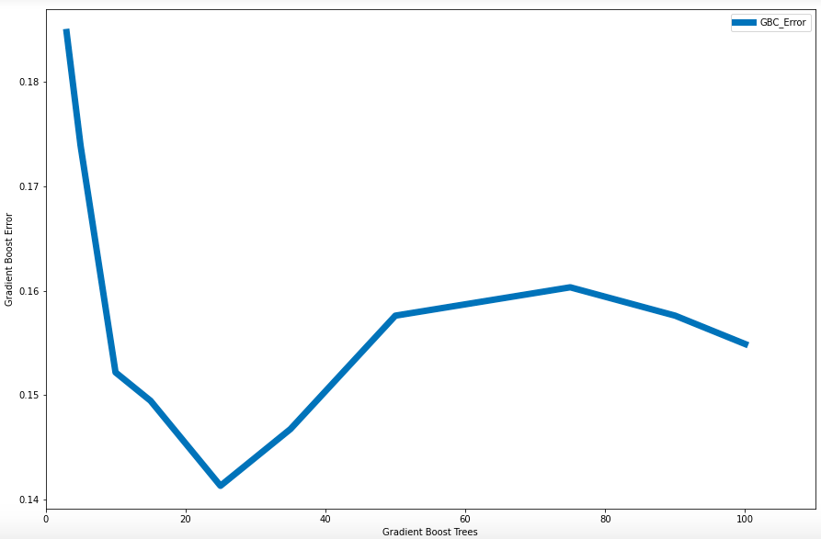
Gradient Boost Model
Trees Range from 3 – 100
Lowest Error at 25 trees
14.13% Error

Slide 11
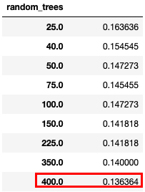
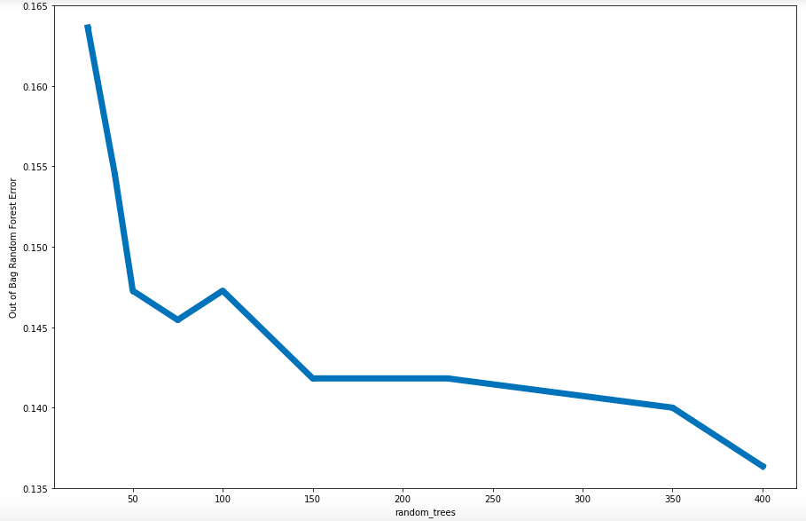
Random Forest Classifier Model
Trees Range from 25 – 400
Lowest Error at 400 trees
13.63% Error

Slide 12

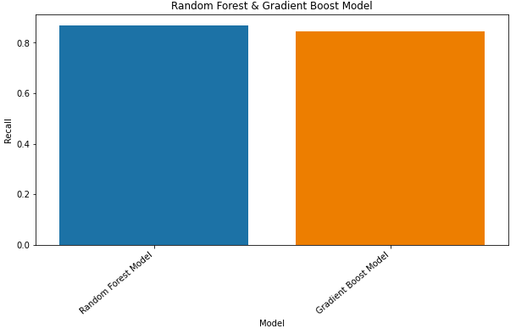
Gradient Boost Vs. Random Forest Classifier Models
Accuracy
Random Forest – 86.68%
Gradient Boost – 85.59%
F1 - Score
Random Forest – 86.74%
Gradient Boost – 85.69%
Recall
Random Forest – 86.87%
Gradient Boost – 84.61%

Slide 13
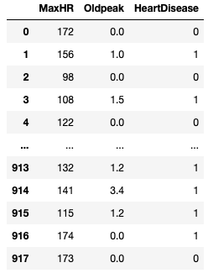
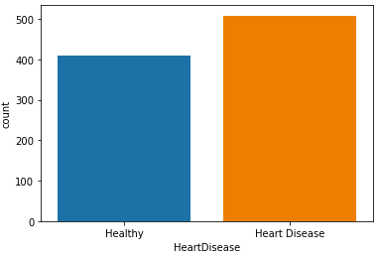
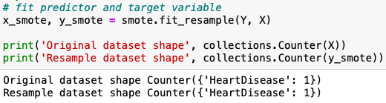
Update and Split Data
Heart Disease Variable uneven 55.3% of patients with heart disease
Fit SMOTE
Oversampling technique even out heart disease variable
Highest correlation Features 40%
Oldpeak
Max Heart Rate

Slide 14
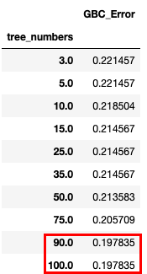
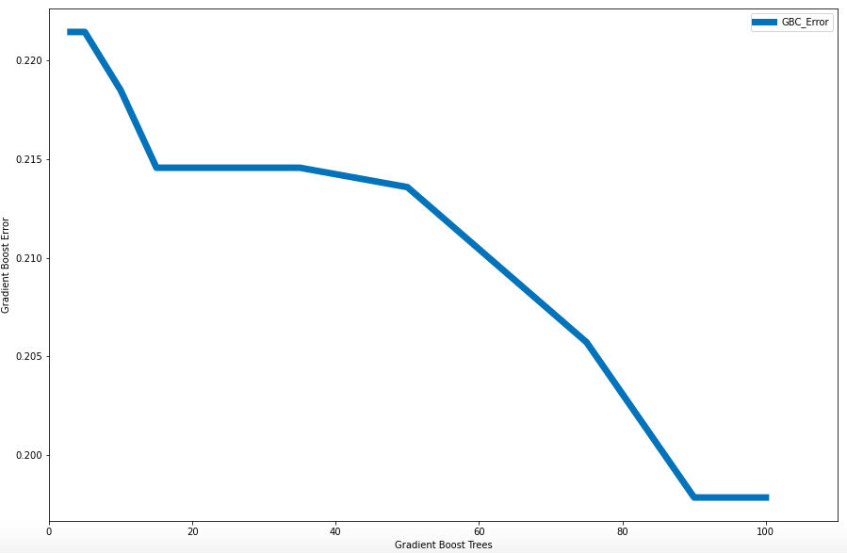
Updated Gradient Boost Model
Trees Range from 3 – 100
Lowest Error at 90 and 100 trees
19.78% Error

Slide 15
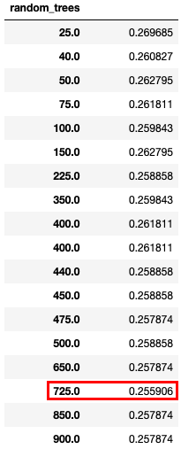
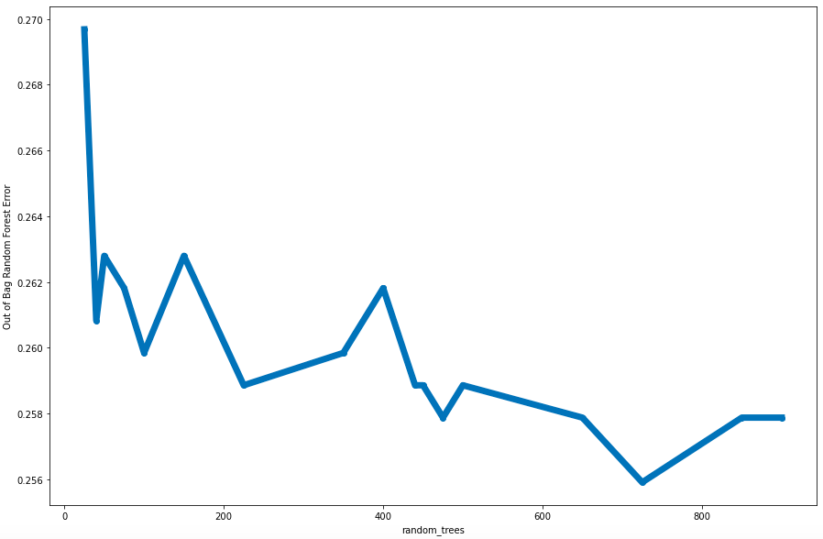
Updated Random Forest Classifier Model
Trees Range from 25 – 900
Lowest Error at 725 trees
25.59% Error

Slide 16
Model Comparison
Minimum Error
Original Models
Gradient Boost – 25 trees at 14.13%
Random Forest– 400 Trees at 13.60%
Updated Models
Updated Gradient Boost – 90 - 100 Trees at 19.78%
Updated Random Forest – 725 Trees at 25.59 %

Slide 17
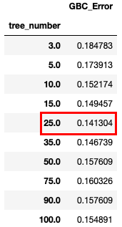
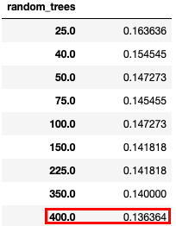

Conclusion and Recommendation
Random Trees Original Model
Lowest Error – 13.63% at 400 trees
F1 – Score – 86.74%
Accuracy – 86.68%
Recall – 86.87%

Slide 18
Reference
World Health Organization. (n.d.). Cardiovascular diseases (cvds). World Health Organization. Retrieved May 27, 2022, from https://www.who.int/en/news-room/fact-sheets/detail/cardiovascular-diseases-(cvds)
Fedesoriano. (2021, September 10). Heart failure prediction dataset. Kaggle. Retrieved May 25, 2022, from https://www.kaggle.com/datasets/fedesoriano/heart-failure-prediction?select=heart.csv
Shah, R. (2020, July 24). Imbalanced classification: Handling imbalanced data using Python. Analytics Vidhya. Retrieved May 11, 2022, from https://www.analyticsvidhya.com/blog/2020/07/10-techniques-to-deal-with-class-imbalance-in-machine-learning/
PARTHASARATHY, SRIRAM. “Top 5 Predictive Analytics Models and Algorithms: Logi Analytics Blog.” Logi Analytics, 12 Feb. 2021, https://www.logianalytics.com/predictive-analytics/predictive-algorithms-and-models/.

